Slide 1
Digital Systems 18B11EC213
Systems and their properties

Slide 2
Contents
Introduction to System
Basic System Properties
Systems with and without memory
Invertibility
Causality
Stability
Time Invariance
Linearity

Slide 3
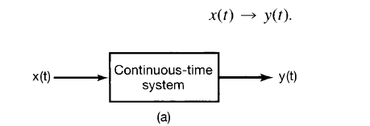

Introduction
A system is an interconnection of components, devices or subsystems.
It processes, transforms or responds to an input x(t) and provides output y(t).
Systems can be classified as :
Continuous Time Systems - Takes continuous time input signal x(t) and gives continuous time output signal y(t)
2. Discrete Time Systems – Takes discrete time input signal x[n] and gives continuous time output signal y[n]

Slide 4
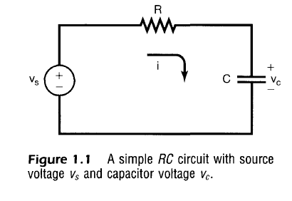



Eq. 1
Eq. 2
Eq. 3
Equation 3 shows the equation of system shown in fig. 1.1, which takes V_{s} as input and provides V_{c} as output across capacitor C.

Slide 5
Basic System Properties
Systems with and without memory
Memoryless systems:
A system is said to be memoryless if output at any time depends on only the input at that same time.
y(t) = Rx(t)
y(t) at any time t depends on the value of x(t) at that time.
(b) Systems with memory:
A system is said to have memory if output at any time depends on the input other than the present time.
y[n] = y[n-1] + x[n]

Slide 6
Causal and Noncausal System
Causal Systems
A system is called causal if its output at the present time depends on only the present and/or past values of the input.
Thus, in a causal system, it is not possible to obtain an output before an input is applied to the system.
y[n] = x[n] + x[n-1] and y(t) = x²(t)
Noncausal Systems
A system is called noncausal (or anticipative) if its output at the present time depends on future values of the input.
y(t) = x(t+1) and y[n] = x[-n]
All memoryless systems are causal systems.

Slide 7
Linear and Nonlinear System
Linearity
A system is said to be linear if it satisfies homogeneity and superposition properties otherwise it will be nonlinear system.
Let y₁ = F(x₁) and y₂ = F(x₂)
Homogeneity
F(ax) = ay
For any scalar a.
Superposition
F(x₁ + x₂) = y₁ + y₂ = F(x₁) + F(x₂)
For any signals x₁ and x₂.
Combining the above two conditions into a single condition we have
F(ax₁ + bx₂) = ay₁ + by₂
Note that a consequence of the homogeneity (or scaling) property of linear systems is that a zero input yields a zero output.

Slide 8
Examples
Check for Time invariant:
(i) y(t) = sin[x(t)]
y(t) = F{x(t)}
F{x(t-t₀)} = sin[x(t-t₀)]
Now, delayed output
y(t-t₀) = sin[x(t-t₀)]
y(t-t₀) = F{x(t-t₀)}
Hence, this is a time invariant system.
(ii) y(t) = tx(t)
y(t) = F{x(t)}
F{x(t-t₀)} = tx(t-t₀)
y(t-t₀) = (t-t₀)x(t-t₀)
y(t-t₀) ≠ F{x(t-t₀)}
Hence, this is a time variant or time varying system.

Slide 9
Examples
Check for Linearity:
(i) y = x²
F(x₁) = x₁²
F(x₂) = x₂²
F(x₁ + x₂) =(x₁ + x₂)² = x₁² + x₁² +2x₁x₂
F(x₁ + x₂) ≠ F(x₁)+ F(x₂)
Hence system is non-linear.

Slide 10
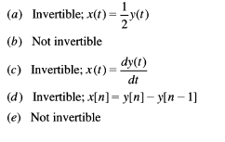
Examples
Check for Invertibility:
(a) y(t) = 2x(t)
(b) y(t) = x²(t)
(c)
(d)
(e) y[n] = nx[n]

